Slide 1
CSCI 473 MPI00.1 Trap4
Lakota Dolce

Slide 2
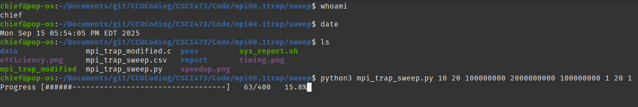
Running on Linux(Pop_OS)
To run on Pop_OS, an offshoot of Ubuntu, you need to make sure that you have everything updated and all required software installed. Req Software: 1) Python ( I used python3)
Matplotlib (python3-matplotlib)
2) A C compiler ( I used gcc)
3) MPI (I used mpich)
4) An image viewer ( I used gimp)

Slide 3
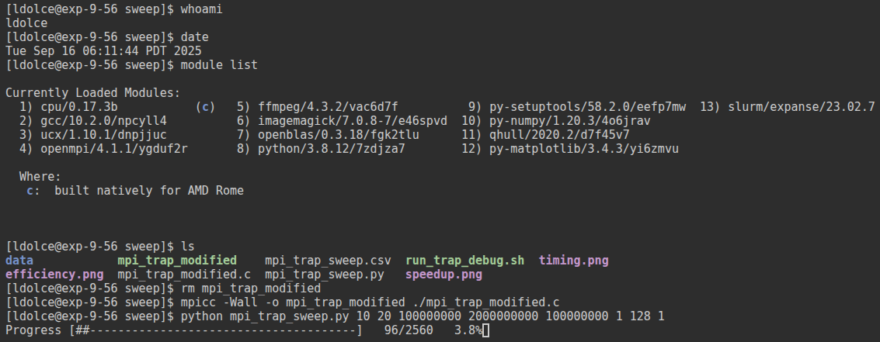
Running on Expanse
To run on Expanse, ensuring all the modules were loaded was the key. Req modules 1) cpu/0.17.3b
2) gcc/10.2.0
2) python3
py-matplotlib/3.3.2-openblas
3) openmpi/4.1.1
4) slurm
Once these are loaded you just need to compile and run the python script.

Slide 4
Problems Faced
Linux: Very minimal problems, I already had most of the software downloaded on my system and only had to add matplotlib to the software, once done, I was able to get the program compiled and ran. Expanse: A few problems occurred with expanse, the biggest one was version issues between modules. The other issue that I faced was that the program would not run in the allotted time for the debug nodes.

Slide 5
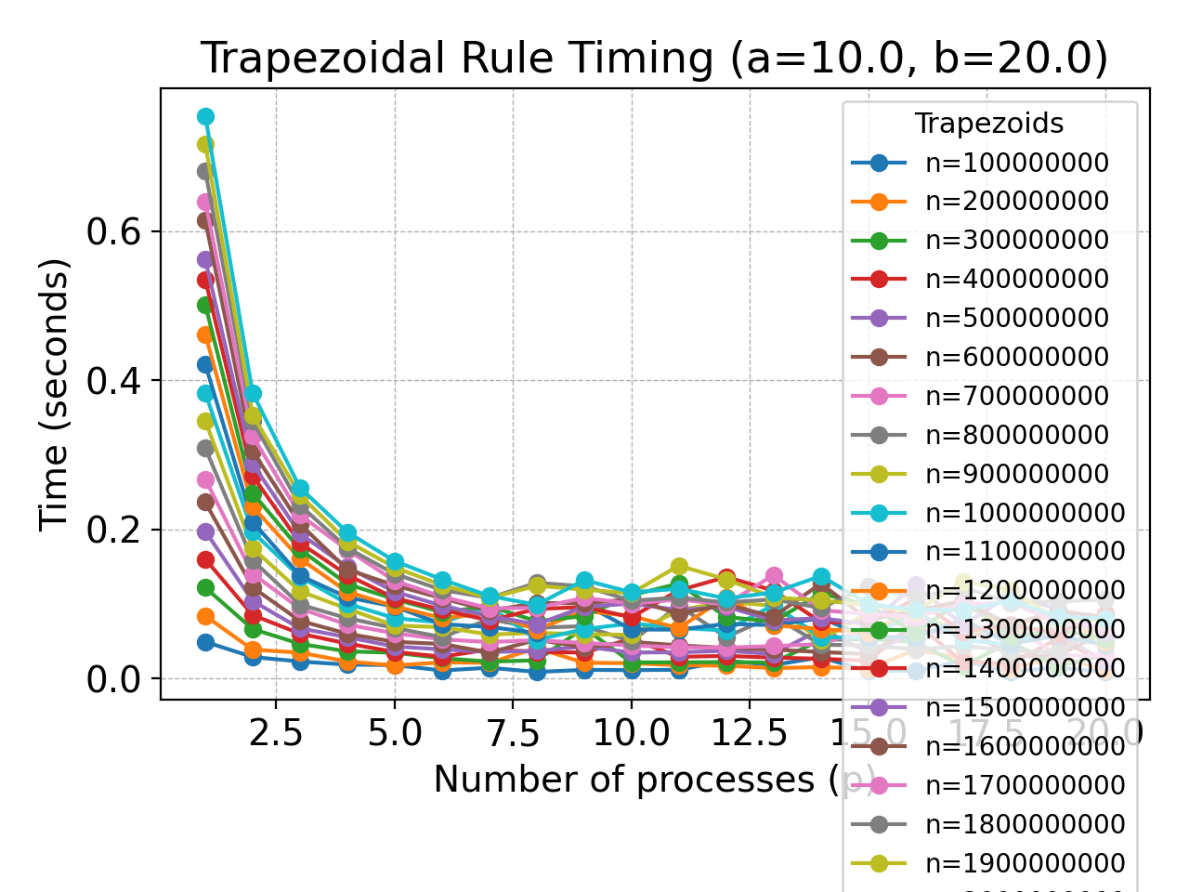
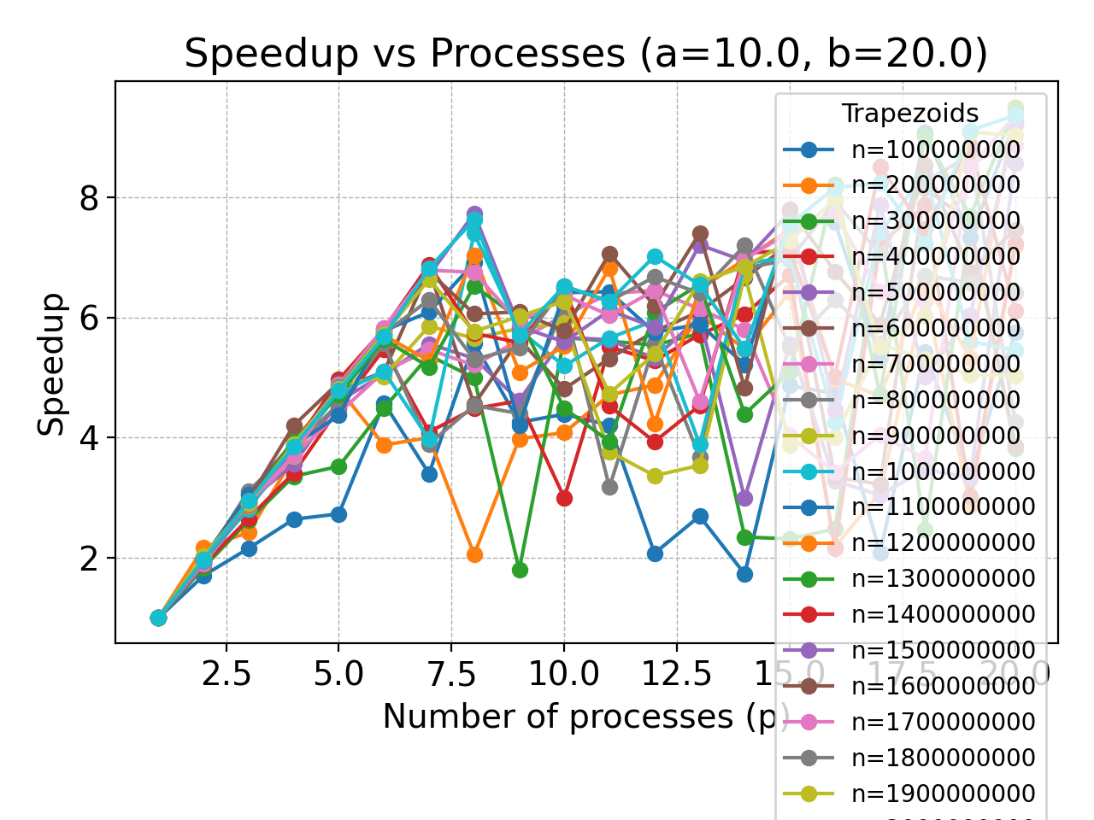
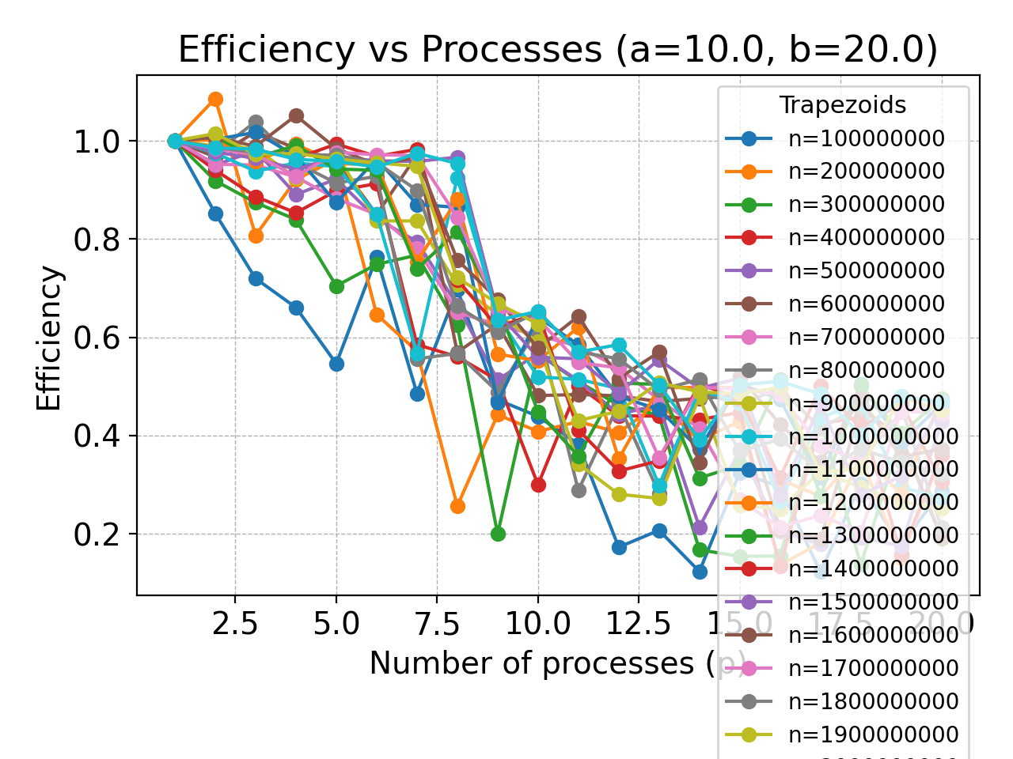
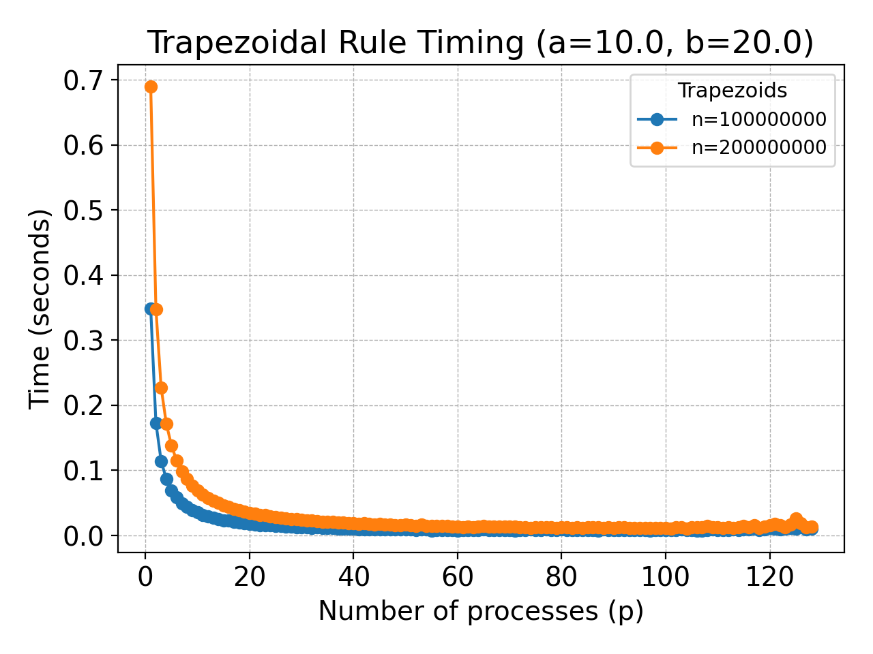
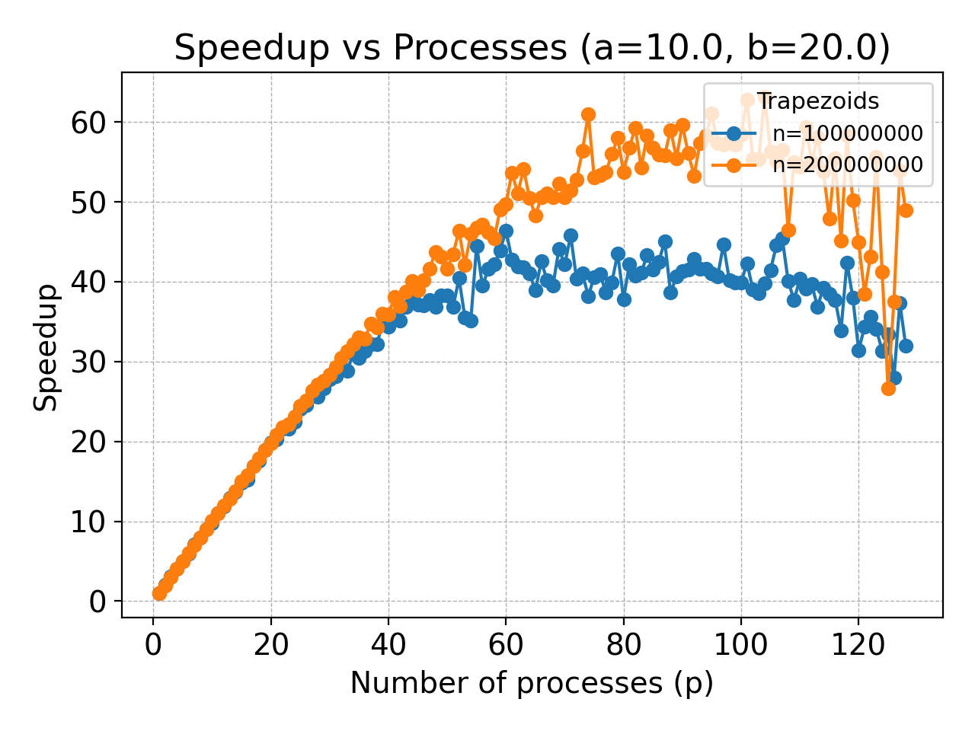
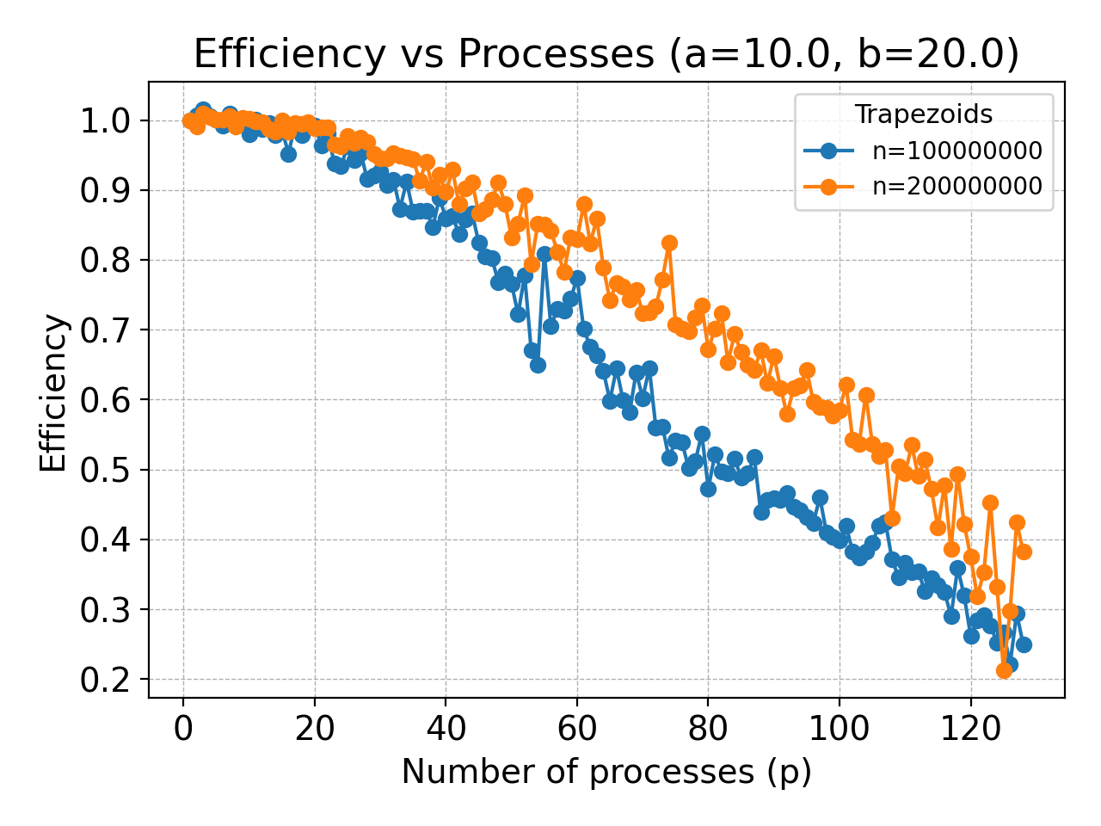
Results
My computer:
Expanse:

